Slide 1

Module 1 Lesson 1 – Data Acquisition
Mental Health Dashboard Building
Module 1 – Data Acquisition and Cleaning
Maria Tomasso, M.S.
met48@txstate.edu
July 2023

Slide 2
LAST TIME
We outlined the mental health resource dashboard that we will be building throughout this series
We identified data sources
We sketched out a rough design of the dashboard
We planned some data transformations that will make implementing the dashboard easier

Slide 3
IN THIS VIDEO
We will discuss good practices to follow while gathering data.
We will review the data sources and documentation for the original MAP dashboard.
We will introduce geocodes with common examples.

Slide 4
GOOD DATA PRACTICES
Make a README as you go.
Save links to datasets with the date accessed.
Give data files descriptive names.
Document any updates to your dataset (this can be done in the README).
Make a metadata file for the final dataset.

Slide 5
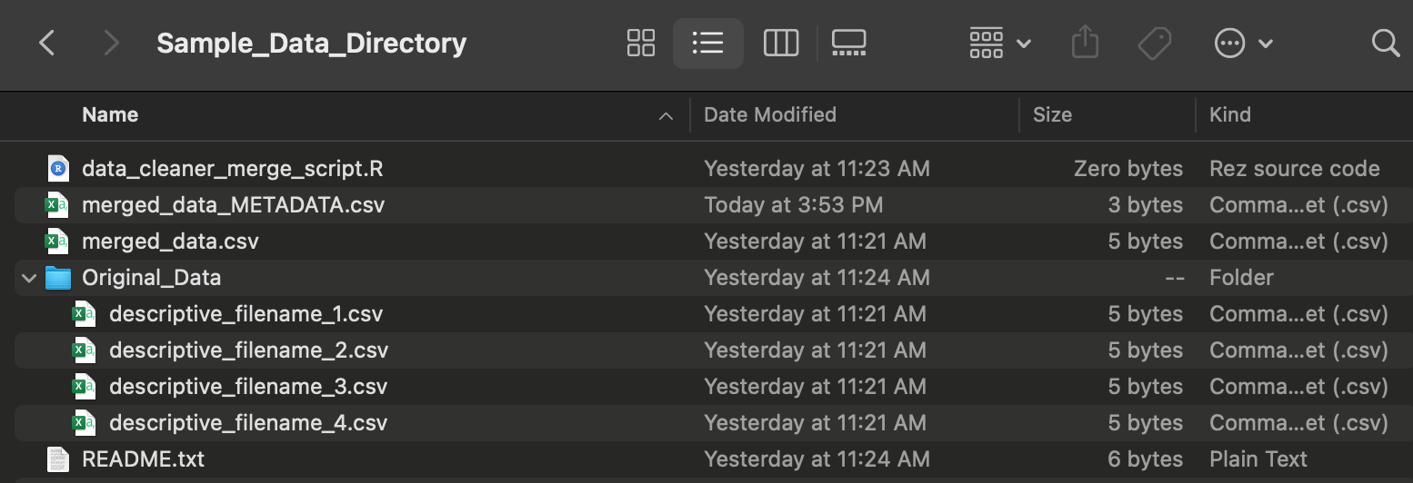
SUGGESTED DIRECTORY FORMAT

Slide 6
MAP DATA AND DOCUMENTATION
All MAP data, code , and documentation is available on our Github page: https://github.com/MariaElise-T/CHERR-mental_health_map

Slide 7
FINDING RELIABLE DATA
Generally, you should seek primary datasets directly from their original publisher if possible.
For example, census data should come from https://data.census.gov/ rather than a secondary source.
If you must use secondary sources, make sure the primary source is cited. Do not use data of unknown origin.
Government data sources (federal, state, county, and city) can provide a wealth of health and demographic data with varying levels of geographic granularity
Reputable nonprofits and/or journalists will sometimes compile datasets from public records and/or FOI requests. These datasets may include variables not available from other sources.
The MAP data uses Texas jail occupancy data compiled by the Vera Institute, a nonprofit that compiled the data from multiple federal surveys. See https://trends.vera.org/methodology/ for full methodology.

Slide 8
MAP DATA SOURCES (Version 2.1)
Federal: Bureau of Labor Statistics (BLS), US Census, Centers of Medicare and Medicaid Services (CMS), Office of the Assistant Secretary for Planning and Evaluation (ASPE), Veteran’s Administration (VA), Centers for Disease Control and Prevention (CDC), National Highway Traffic Safety Administration (NHTSA), Office of Inspector General (OIG), Substance Abuse and Mental Health Services Administration (SAMHSA), National Forensic Laboratory Information System (NFLIS), Federal Bureau of Investigation (FBI)
State: Texas Department of State Health Services (DSHS), Texas Office of Court Administration, Texas Education Agency, Texas Open Data Portal
Nonprofit: The Vera Institute

Slide 9
GEOGRAPHICAL DATA
Population health data will often be reported by geographic region (e.g., state, county, ZIP code, congressional district, school district, census tract).
A geocode is a unique identifier of a geographic entity.
FIPS codes are common geocodes in health data. FIPS codes are 5-digit codes corresponding to counties where the first two digits represent the state and the last three represent the county.
Tableau can automatically map some geocodes (like FIPS) to a map.
Since geocodes are unique, they are also useful when merging datasets.

Slide 10
RECAP
In this video, we discussed good practices to follow when searching for and collecting data from open public sources.
We reviewed the data sources and documentation for the MAP dataset as an example to follow when collecting the data for our resource library.
We defined geocodes and their uses in data analysis and dashboard building.

Slide 11
WHAT’S NEXT?
In the next video, we will apply what we’ve learned to the resource dashboard datasets we introduced in Module 0 Video 2.
PRACTICE: Using the README and metadata file for the MAP project, find the original data source and definition for the ‘Traffic_Fatalities_per_100k’. Hint: The metadata file can be found in the ‘snapshot_county_data’ folder.

Slide 12





FOLLOW US
https://public.tableau.com/app/profile/translational.health.research.center
https://twitter.com/txst_thr
https://healthresearch.txst.edu/
https://www.linkedin.com/company/texas-state-university-translational-health-research/
https://www.youtube.com/@txst_THR

